Slide 1
Big Question
What does it mean to be a Jew?

Slide 2
LQ: What is the significance of The Shema?

Slide 3
What do we already know about the Jewish faith?
What do promises mean?
LQ: What is the significance of The Shema?
?

Slide 4
What is the Shema to Jewish people?
LQ: What is the significance of The Shema?
?

Slide 5
What is the Shema to Jewish people?
The Shema is regarded by many Jews as the most important prayer in Judaism. This is because it reminds them of the key principle of the faith - there is only one God.
LQ: What is the significance of The Shema?
?

Slide 6
What is the Shema to Jewish people?
Watch...
LQ: What is the significance of The Shema?
?

Slide 7
If I walked into your house what would I see that would give me clues about you and your family?
This could be:
Something supporting your faith
Something showing your hobbies
A favourite photo
Rules for your family
LQ: What is the significance of The Shema?
?

Slide 8
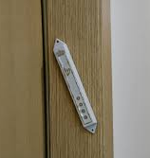
Jewish people believe in one God. The Mezuzah contains important declarations about who God is which underpins their faith.
Watch...
LQ: What is the significance of The Shema?
?

Slide 9
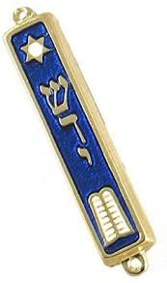
A declaration is a statement about something. So the Mezuzah contains a statement about their God.
Jews touch this as they go in and out of their houses.
LQ: What is the significance of The Shema?
?

Slide 10
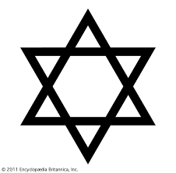
When you make an agreement with someone what do you expect?
Does there need to be trust involved?
LQ: What is the significance of The Shema?
?

Slide 11
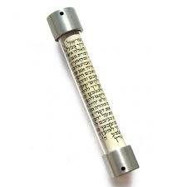
If you have made an agreement how can you make people remember this?
LQ: What is the significance of The Shema?
?

Slide 12
Your task…
Can you create your own declaration about you and your family. This could be based on the Faith you follow or it could be the promises and agreements that you as a family follow.
©
Where could this agreement/declaration be found in your house. Would it be kept somewhere where people could see? Would you read it/touch it each day?
LQ: What is the significance of The Shema?
?

